Slide 1
Unit- 6
Sequential Logic Circuits Applications
Course: ECE249: Basic Electrical & Electronics Engineering

Slide 2
Outline
Applications of sequential Logic Circuits
Digital system Components
  Registers
  Counters
  Memory
Register in Details
  4 bit Register
  Register with Parallel Load & FF
  Shift Register
  SISO, PIPO, SIPO, PISO Operations of Shift Register

Slide 3
Applications of sequential Logic Circuits
Digital System Components: Registers, Counters and Memories.
Specific Uses:
  Register: to facilitate the design of sequential circuits.
  Counter: For generating timing variables to sequence and control the operations in a digital system.
  Memory: to storage of programs and data in a Digital Computer.
Knowledge of all these three is essential to understand the design of digital systems.

Slide 4
Register
Definition: A register is a group of binary cells suitable for holding binary information.
A group of flip flops constitutes a register. Each flip flop is a binary cell capable of storing one bit of information.
n-bit register has a group of n flip flops and is capable of storing any binary information containing n bits.
Example: Various Registers of 8085 processor

Slide 5
Counters
Definition: A counter is essentially a register that goes through a predefined sequence of states upon the application of input pulses.
Example: Up-Counter, Down-Counter.

Slide 6
Memories
Definition: A memory unit is a collection of storage cells together with associated circuits needed to transfer information in and out of storage.
Example:
RAM - Random Access memory. also called as Read-Write Memory
ROM - Read Only Memory

Slide 7
Registers - Detail
Simplest Register: Consists of only flip flops without any external gates.
Register constructed with 4 D-FF and a common clock pulse input makes 4-bit Register
Function: CP enables FF, information at the four inputs is transferred into the 4-bit register, 4 O/P’s sampled to obtain the information presently stored in the register.

Slide 8
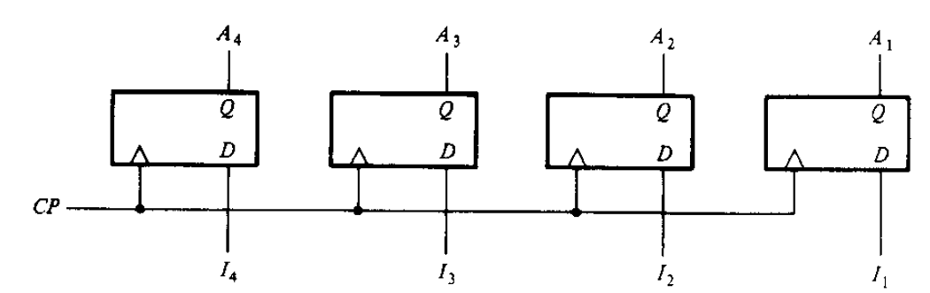
Cont…
Figure.1: 4-bit Register

Slide 9
Shift Registers
Definition: A register capable of shifting its binary information either to the right or to the left is called a shift register.
Configuration of Shift Register: Chain of flip flops connected in cascade (output of one FF connected to the input of the next FF) + All FFs Rxs common CP causes the shift from one stage to the next.

Slide 10
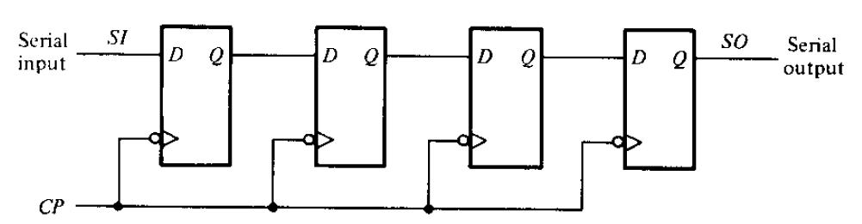
Shift Register – Construction & Operation

Slide 11
Cont…
Simplest register is one that uses only flip flops
The Q O/P of given FF is connected to the D-I/P of the FF to its right.
Each CP shifts the contents of the register one bit position to the right
The serial input determines what is to be serially registered.
The serial O/P is taken from the output of the rightmost FF.
Left to right / Right to left shifting of the content is possible.

Slide 12
Cont…
7. Based on as above (6) Shift-right or Shift-Left register.
8. For the given D FF, shifting happens during the negative edge of the pulse transition.
9. Control of shift register is possible only with certain pulses but not with others
shift operations can be controlled through the D inputs of the FF rather than CP.
SI – Input ; SO- Serial Output; hence it is also called as SISO (Serial In Serial Out Register)

Slide 13
Shift Register Modes:
1. Serial and Parallel Modes
  Serial Mode (Serial In Serial Out, SISO):
    The Reg have a Single Serial Input & Single Serial Output, information is transferred one bit at a time, in the same direction
  Parallel mode (Parallel In Parallel Out, PIPO):
    All the Reg bits information is loaded in & out in parallel i.e., in a single clock pulse
2. Serial & Parallel Combination Mode:
  Serial In Parallel Out (SIPO) :
    Reg Loaded Serially and send out in parallel
  Parallel In Serial Out (PISO);
    Reg Loaded in Parallel and send out serially

Slide 14
Cont… - Defn
Bidirectional Shift Register: A register capable of shifting both right and left is called a bidirectional shift register.
Unidirectional Shift Register: A register can shift only one direction is called a uni-directional shift register.
Shift Register with Parallel Load: The register has both shift and Parallel-load capabilities, is called as Shift register with Parallel Load.

Slide 15
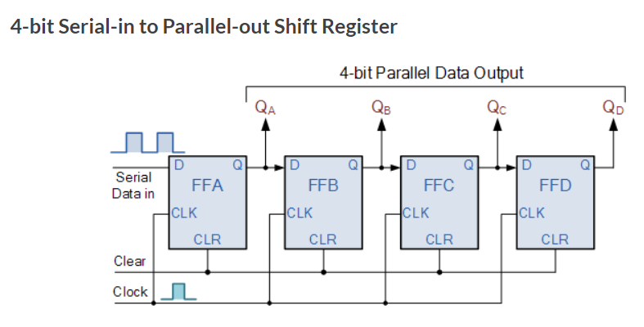
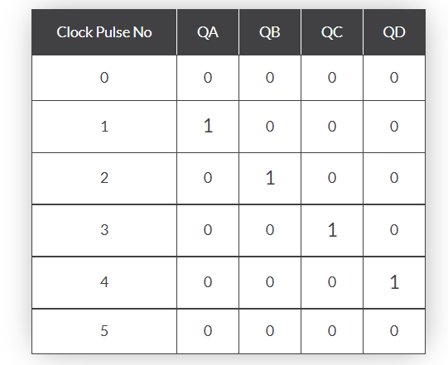
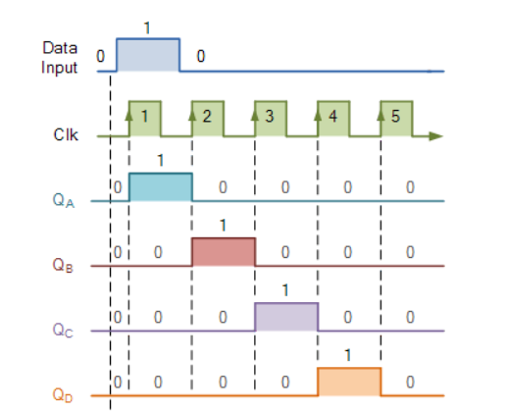
Serial-In Parallel-Out shift Register (SIPO)

Slide 16
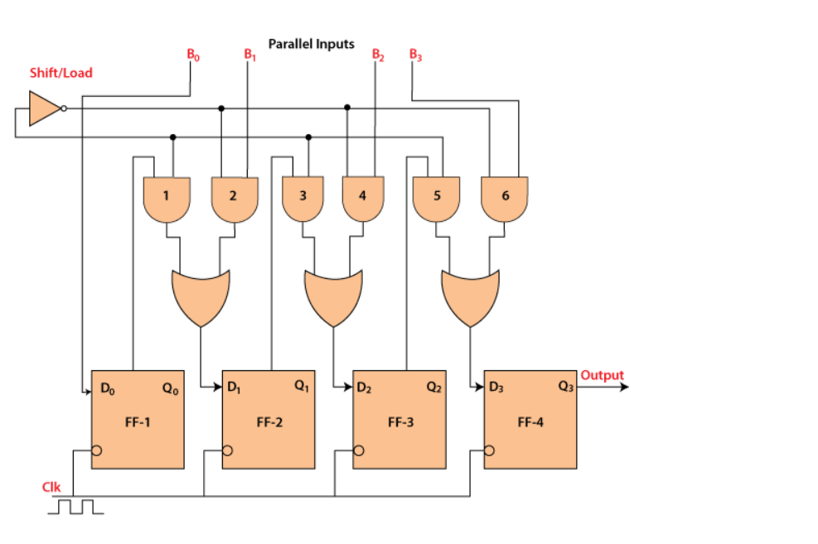
Parallel-In Serial-Out Shift Register (PISO)

Slide 17
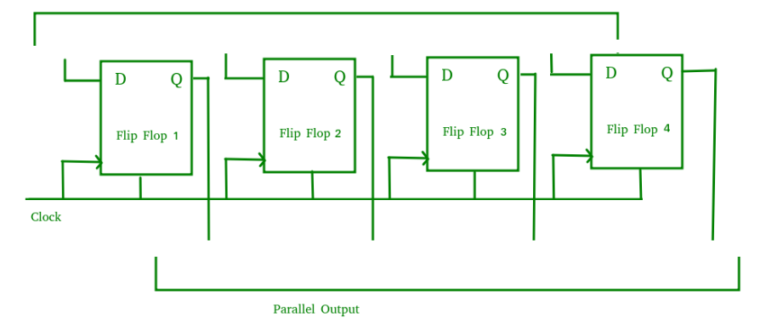
Parallel-In Parallel-Out Shift Register (PIPO)

Slide 18
References
[1] Digital Logic and Computer Design by Morris Mano, 2nd Edition, PP-257- 268.

